Slide 1
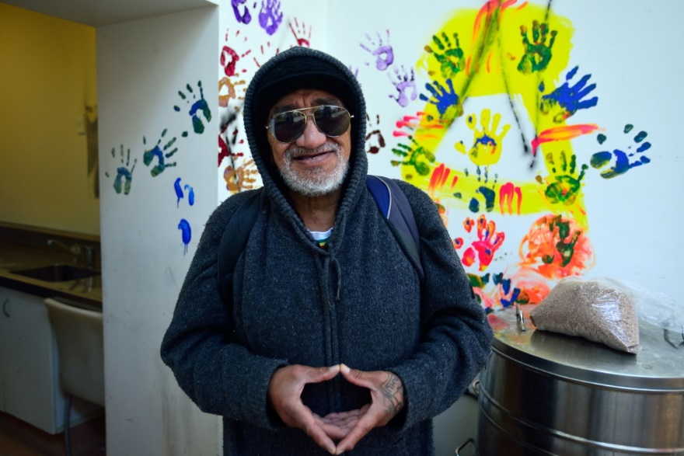

Slide 2
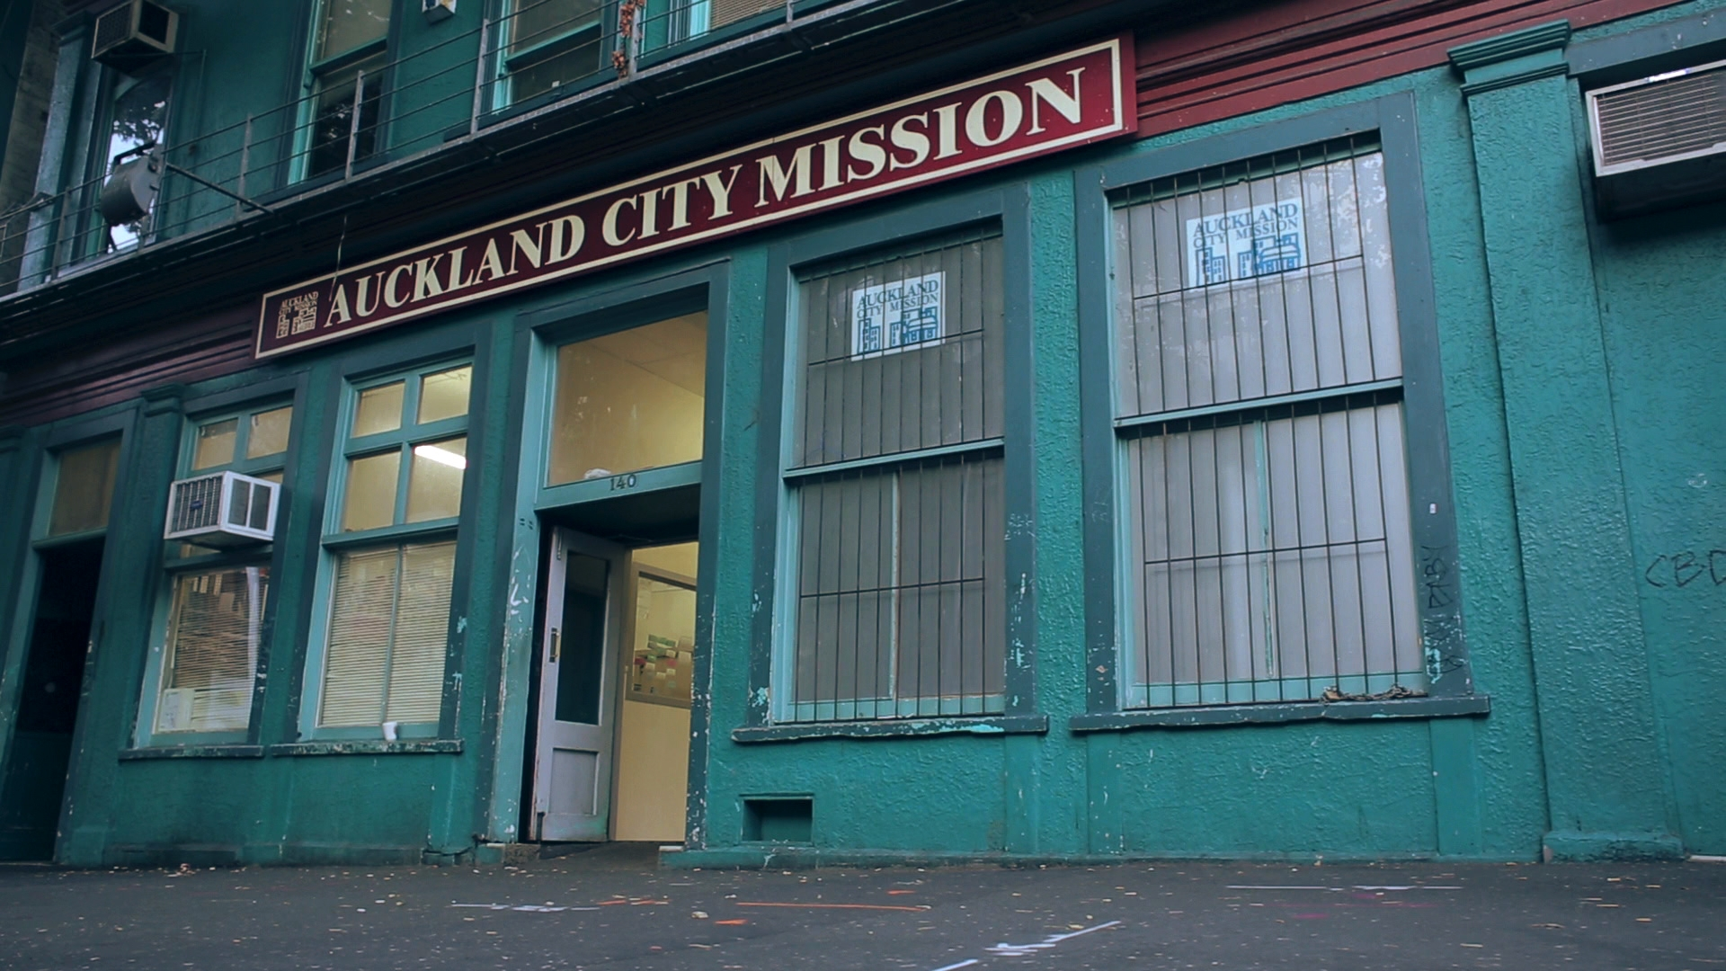
Our Mission
Together we stand with those in desperate need.
We provide immediate relief and pathways to enable long-term wellbeing.
Notes:
Work directly with clients, advocate to the government, collaborate with other agencies.

Slide 3
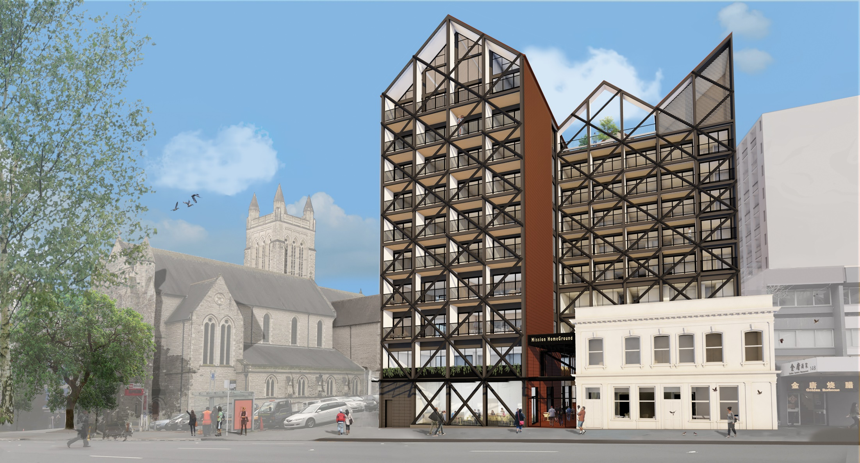
100 years of Service
Together we stand with those in desperate need.
We provide immediate relief and pathways to enable long-term wellbeing.
In our 100th year of service, the Mission now looks to the future with the transformational HomeGround project.
Notes:
Work directly with clients, advocate to the government, collaborate with other agencies.

Slide 4
How the Mission Helps:
3 Pillars
Hunger
Homelessness
Health
Notes:
Work directly with clients, advocate to the government, collaborate with other agencies.

Slide 5
How the Mission helps: Hunger
Before COVID-19?
Approximately 10% of New Zealand’s population were experiencing food insecurity.
Now?
Approximately 20%.
Food insecurity means not having enough appropriate food. It is the state of being without reliable access to a sufficient quantity of affordable, nutritious food.

Slide 6
How the Mission helps: Hunger
Before COVID-19?
The Mission provided approximately 450 food parcels a week.
Now?
Approximately 1,000
(and at the height of lockdown 1,246).
A food parcel typically feeds a family of 4 for up to 4 days and includes meat, dairy, fresh fruit and veg, canned food, pasta, rice, tea, coffee and other pantry staples.

Slide 7
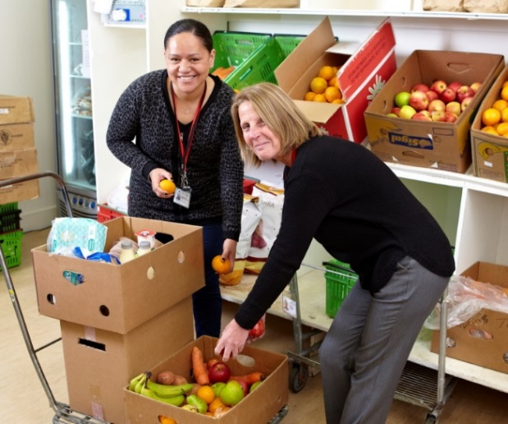
How the Mission helps: Hunger
Future?
Expect to continue supporting at the same level as the economic impact of COVID-19 continues.
Working with other agencies for long-term solutions.

Slide 8
How the Mission helps: Homelessness
During COVID-19 needed to provide somewhere for people experiencing homelessness to ‘self-isolate’.
Accommodation provided for approximately 200 people.

Slide 9
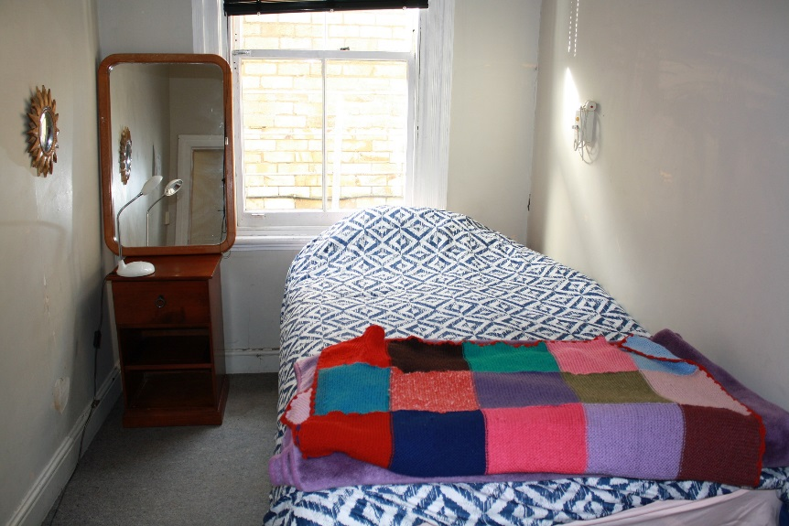
How the Mission helps: Homelessness
Tenanted people in vacant motels and hotels.
Provided wrap around support and care including daily meal service.
Opened a new transitional housing programme in the middle of lockdown.

Slide 10
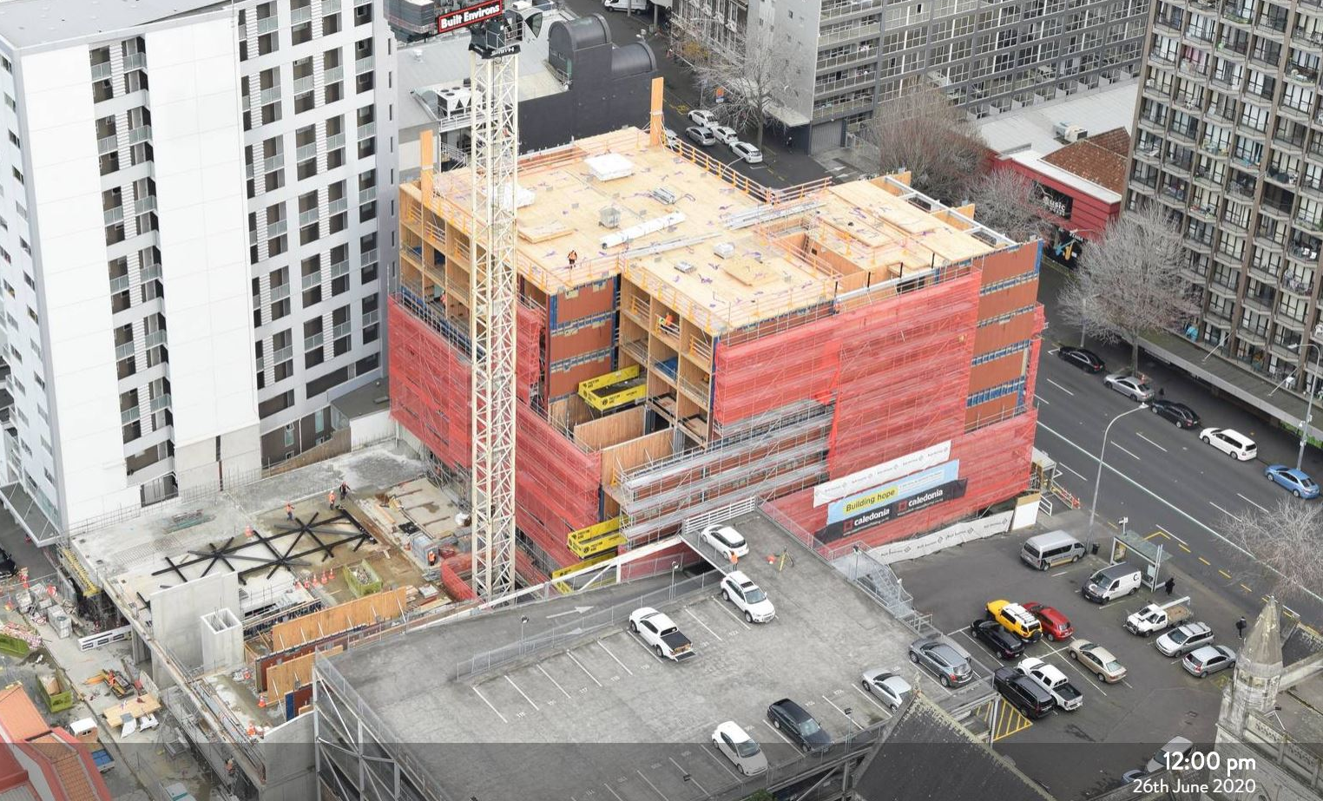
How the Mission helps: Homelessness
Future?
Offering permanent homes to those in temporary accommodation.
HomeGround is one solution.

Slide 11
How the Mission helps: Health
Calder Health Centre is one of the country’s most complex medical practices.
Virtual and phone consultations.
Tent and mobile testing stations.

Slide 12
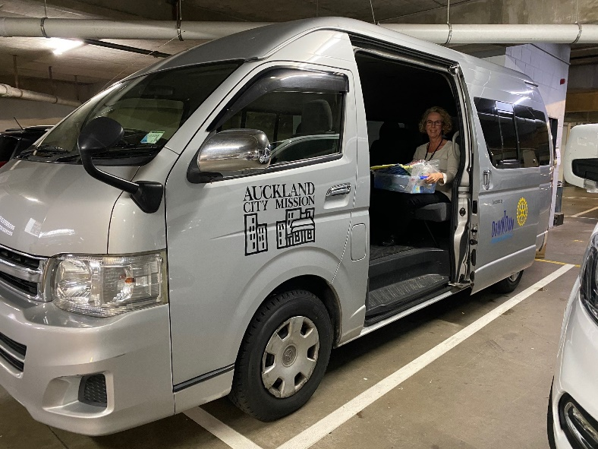
How the Mission helps: Health
Currently running a mobile health unit to reach those people in motels and hotels around the city.
Face to face consultations available once again.

Slide 13
How the Mission helps: Health - Detox
Closed during COVID-19 due to isolation protocol.
Repurposed to allow for social distancing at transitional housing programmes.
Now operating again at full capacity.
Currently based in Avondale, the Mission’s detox has 10 beds – half of Auckland’s availability.

Slide 14
New Normal post COVID-19
Hunger: continuing to support the increased number of people experiencing food insecurity.
Homelessness: transition people who are currently in temporary accommodation into permanent homes.
Health: provide a mixture of on-site and mobile health services.
And take learnings from our experiences in COVID-19 to improve the Mission and the lives of those people we support.
Notes:
Work directly with clients, advocate to the government, collaborate with other agencies.

Slide 15
Find out more at
aucklandcitymission.org.nz
QUESTIONS?

